Slide 1
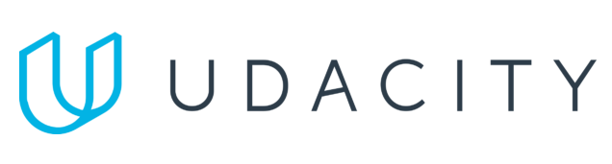
Data Lake Value Proposition
Medical Data Processing Company
Srijana Thapa
Udacity IPS Version 1.0

Slide 2
Agenda
What is a Data Lake
Components of a Data Lake
Data Lake vs Data Warehouse
Business Value of Data Lake Solution
Proposed Data Lake Architecture for Medical Data Processing system
Udacity IPS Ver. 1 2/2020

Slide 3
What is a Data Lake
A data lake is a centralized storage system that holds large volume of raw data in its native format.
Structure data
semi- Structure data
Unstructured data
Enables real-time and bath processing
Schema on read
Scalable & cost- effective

Slide 4
Components of Data Lake
Ingestion – Tools to ingest data
Tools like- Apache Kafka, Apache sqoop
Processing- Tools to process the Data in Data Lake
Tools like- Hadoop MapReduce, Hive, Pig, Spark
Storage- Stored Data at Scale in a Data Lake
Hadoop HDFS
Serving- Presenting the Data or Results
Apache HBase, PostgreSQL

Slide 5
Data Warehouse
Data Lake
Structured data
Schema-on-write
Batch Processing
Higher Cost
Store raw data
Schema-on-read
Batch and real-time data Processing
low Cost
Udacity IPS Ver. 1 2/2020

Slide 6
Business Value of Data Lake
Centralized Data Storage
Store all type of medical data in one place
Real –time Analytics
Support real-time data processing
Scalability and flexinility
Cost effective
Reduces costs compared to traditional storage solutions.

Slide 7
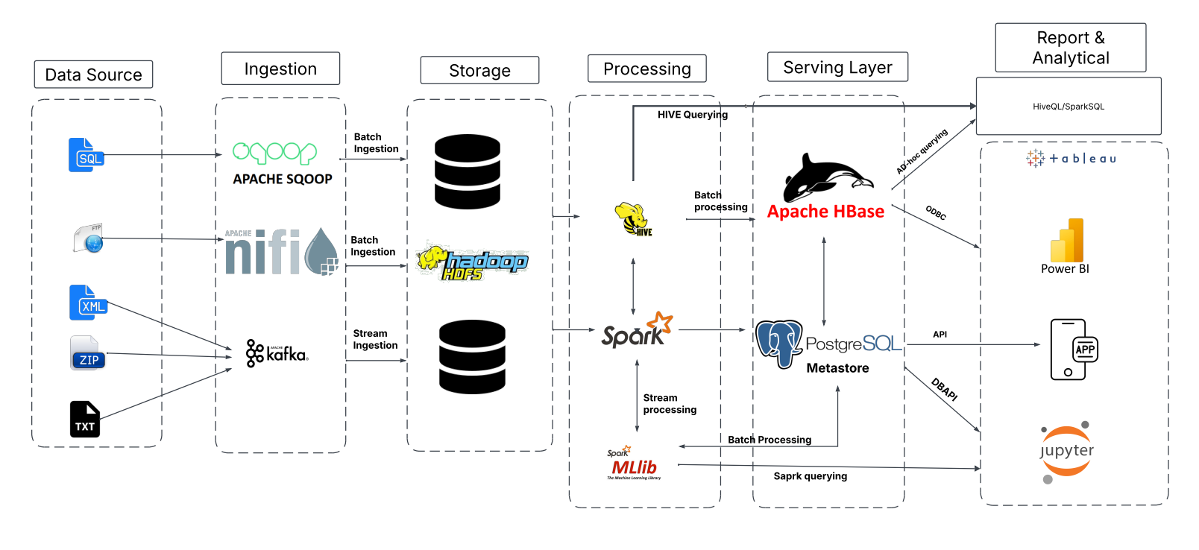
Data Lake Architecture

Slide 8
THANK YOU
Udacity IPS Version 1.0

